Slide 1
Dystrophin conferral using human endothelium expressing HLA-E in the non-immunosuppressive murine model of Duchenne muscular dystrophy. Author(s): Chang-Hao et al
Richard Ekanem
Biology 506 HMG
November 28, 2011

Slide 2
OVERVIEW
Introduction to DMD
Objective(s) of the research
Experimental Design/Results
Summary
Future Research

Slide 3
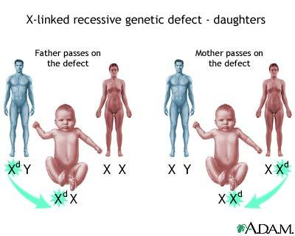
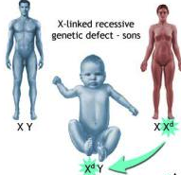
FACTS ABOUT DMD
Recessive X-linked form of muscular dystrophy
Mutation in dystrophin gene (Xp21)
Muscle degeneration, paralysis, death
No known cure for DMD
1 of 3600 male infants
Gene therapy
Cell-based therapy using different cell populations with myogenic potential
Notes:
DMD is a sever recessive X-linked form of muscular dystrophy, characterized by rapid progression of muscle degeneration that eventually leads to loss in ambulation, paralysis and death.
The disorder is caused by a mutation in the gene encoding dystrophin, an important structural component of muscle tissue. The absence of intact dystrophin results in destabilization of the extracellular membrane-sarcolemma-cytoskeleton architecture, making muscle fibers susceptible to contraction associated mechanical stress and degeneration.

Slide 4
Cell-Based Therapy
Transplant rejection
Rejection is caused by mismatch of Human Leukocyte Antigens (HLAs)
HLA-E is a ligand of CD94/NKG2A receptors
The interaction of HLA-E with the inhibitory CD94/NKG2A receptor results in the inhibition of NK cell and CTL dependent lysis
HLA-E plays an important role in immunosuppressio
Notes:
In cell based therapy, donor cells are frequently rejected by recipients when transplanted in an allogenic combination. Rejection is caused by a mismatch of HLAs. There are a large number of different alleles of each HLA, so a perfect match of all HLAs between donor cells and host cells is extremely rare. HLA-E is a non classical MHC 1b molecule, which plays an important role in immunosuppression

Slide 5
Experimental Objective
The goal of the experiment was to investigate the immunomodulating effect of HLA (MHC 1b) in a xenogeneic model using placental-derived cells expressing HLA-E
Human placental artery-derived endothelial (hPAE) cells conferral of dystrophin to myocytes in immunocompetent mdx mice, a model of DMD.

Slide 6
Experimental Design/Results
Derivation of hPAE cells from placental arteries
Expression of HLA-E in hPAE cells by cytokine
Myogenic induction of hPAE cells in vitro labeled with EGFP
Direct implantation of hPAE cells into immunocompetent BALB/c mice
Inhibition of HLA-E by siRNA
Conferral of human dystrophin by cell implantation in the mdx mouse

Slide 7
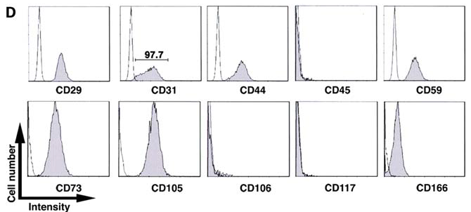
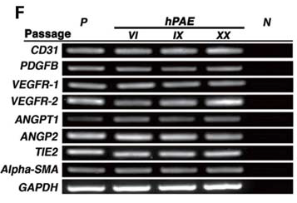
Derivation of hPAE cells
Almost all cells were positive for the endothelial marker CD31
RT-PCR also revealed that the cells were of endothelial origin

Slide 8
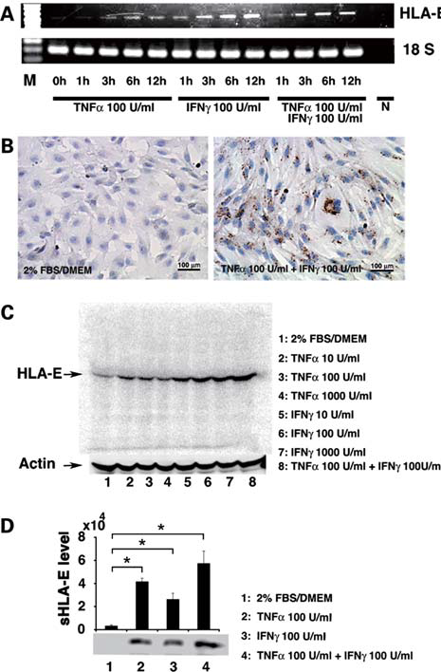
Expression of HLA-E in hPAE Cells
Exposure of hPAE to cytokines
Transcriptional level
HLA-E localization in cytoplasm
Western blot using anti-HLA-E specific monoclonal Ab shows a single discrete band at 42 kDa
Immunoprecipitation analysis of cell supernatant showed a single band at 37 kDa, consistent with soluble HLA-E protein.
Notes:
a) hPAE cells started to express HLA-E after exposure to cytokines at the transcriptional level. B) Immunostaining showing localization of HLA-E in the cytoplasm. C) Western blot analysis using anti-HLA-E specific monoclonal Ab revealed a single discrete band at 42 kDa, consistent with the molecular weight of HLA-E protein. D) Immunoprecipitation analysis of the cell supernatant showed a single band at 37 kDa, consistent with the molecular weight of soluble HLA-E protein, implying that sHLA-E is secreted. The expression of MHC molecules is regulated by cytokines. The interferon and TNF have been shown to increase the expression of MHC 1 molecules on cell. For example, IFN gamma appears to induce the formation of a specific transcription factor that binds to the promoter sequence flanking the MHC I genes.

Slide 9
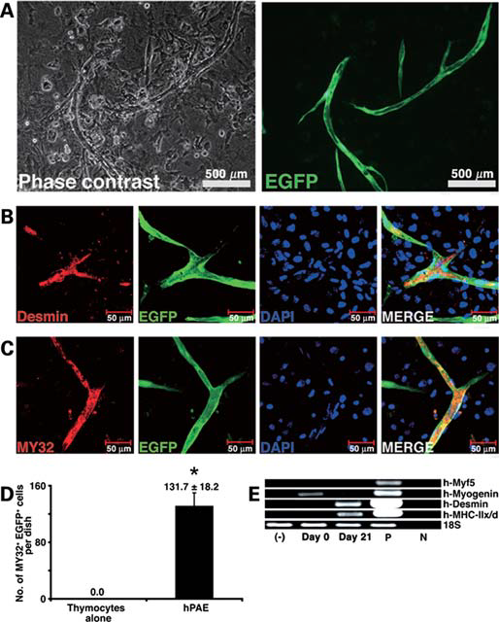
Myogenic induction of hPAE cells in vitro
Differentiation of hPAE into skeletal muscle
Myogenic differentiation of hPAE cells
Expression of myogenic markers
Expression of myosin heavy chain
Quantitative analysis of myosin
Myogenesis of hPAE cells analyzed by RT-PCR with primers that amplify myogenic gene but not that of mouse
Notes:
E. Myogenesis of hPAE cells was also analysed by RT-PCR with primers that amplify human myogenic genes, but not their mouse counterparts. hPAE cells constitutively expressed the myogenin gene and started to express the desmin and MyHC-Iix/d genes after induction.

Slide 10
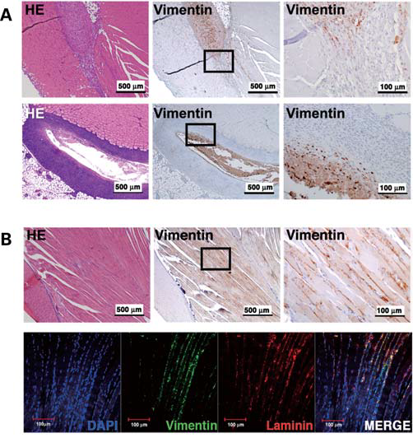
Implantation of hPAE cells into BALB/c mice
in vivo response of hPAE cells
Injection of periosteal cells and hPAE cells into thigh muscle of BALB/c mice.
Immunohistochemistry analysis performed on the muscle section using Ab against vimentin, 2 days and 2 weeks after injection.
hPAE cells fail to elicit pro-inflammatory response in BALB/c mice
Migration of hPAE cells between muscular fibers
Notes:
To further evaluate the in vivo response to hPAE cells, cells were directly injected into the thigh muscles of immunocompetent BALB/c mice. For comparison, periosteal cells with low expression of HLA-E were injected in the same manner. Histopathological analysis revealed that the injection of periosteal cells induced an immune response at the injected sites (4A) but hPAE cells did not (4B), suggesting that hPAE cells fail to elicit pro-inflammatory responses in immunocompetent mice. Immunohistochemical analysis, using Ab specific to vimentin, revealed that hPAE cells extensively migrated between muscular fibers.

Slide 11
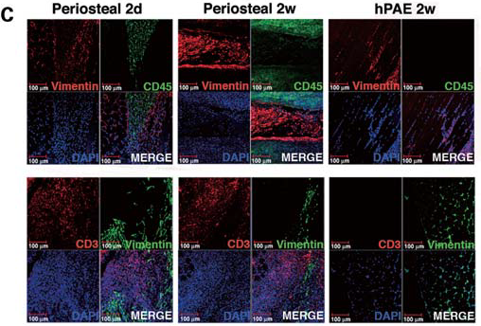
Implantation of hPAE cells into BALB/c mice
Immunohistochemical analysis of thigh muscle sections at 2 days and 2 weeks after injection of hPeriosteal and 2 weeks after injection of hPAE cells; using ABs against vimentin, leukocyte marker CD45 and T cell marker CD3.
CD45 and CD3- positive cells were not detected around the vimentin-positive hPAE cells at 2 weeks
Notes:
Immunofluorescent analysis revealed that CD45 and CD3 lymphocytes infiltrated near the donor periosteal cells at 2 days after the injection into the BALB/c muscle, and the number of lymphocytes increased at 2 week. In contrast, CD45 and CD3 positive cells were not detected around the vimentin-positive hPAE cells at 2 weeks.

Slide 12
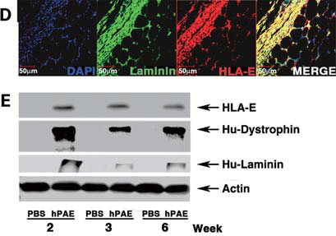
Expression of HLA-E by hPAE cells in vivo
Immuofluorescent analysis using Ab against HLA-E and human laminin on the thigh muscle sections at 2 weeks after injection of hPAE cells.
Western blot analysis showing the level of HLA-E, dystrophin and laminin.

Slide 13
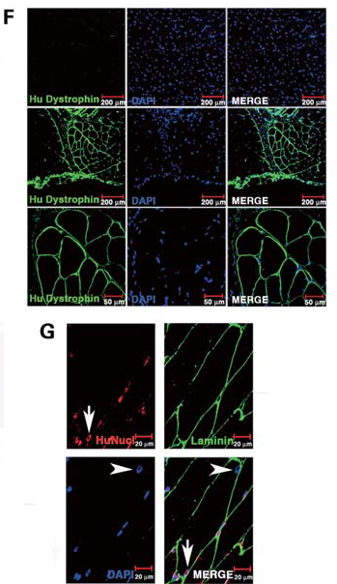
hPAE cells generate muscle tissue in vivo
hPAE cells and PBS implanted directly into thigh muscle of BALB/c mice using human specific Ab
Myotubes at the injected site expressed human dystrophin as a cluster
Dystrophin is transcribed from the dystrophin gene of human donor cells after the hPAE cells differentiated into myotubes and fused to host myocytes without immune response.
Dystrophin expression is attributed to fusion between murine host myocytes and human donor cells.

Slide 14
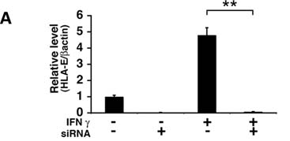
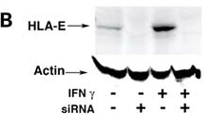
Inhibition of HLA-E by siRNA in hPAE cells
HLA-E involvement in immunosuppression
Suppressed HLA-E expression by siRNA in hPAE
Decrease in HLA-E mRNA and protein in cells transfected with HLA-E specific siRNA

Slide 15
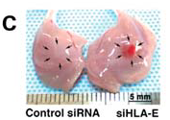
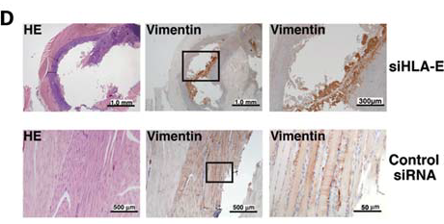
Inhibition of HLA-E by siRNA in hPAE cells
To investigate the involvement of HLA-E in in vivo immune response
after pre-treatment with 20 μM siHLA-E for 48, hPAE cells injected into thigh muscle of immunocompetent BALB/c
hPAE cells treated with control siRNA injected into the contralateral muscles as control.

Slide 16
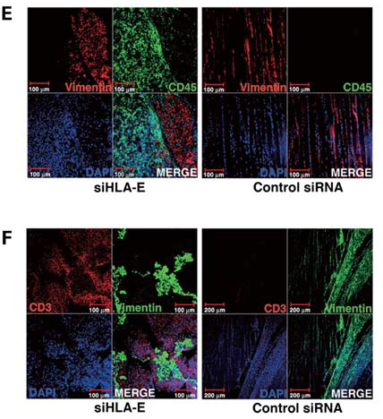
Inhibition of HLA-E by siRNA in hPAE cells
Evidence of immune response
Infiltration of CD3 and CD45 lymphocytes in BALB/c mice 7 days after injection
Result shows that HLA-E is necessary for inhibition of an immune reaction in vivo
Notes:
Histopathological analysis revealed that injection of siHLA-E treated hPAE cells elicited an immune response, as revealed by infiltration of CD3 and CD45 positive lymphocytes in immunocompetent BALB/c mice 7 days after injection, whereas

Slide 17
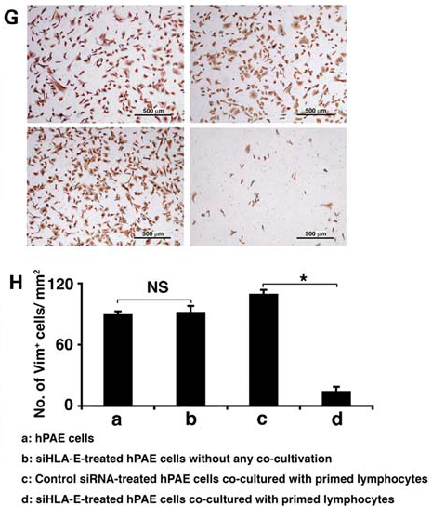
Inhibition of HLA-E by siRNA in hPAE cells in vitro
Investigated whether lysis of hPAE cells by primed lymphocytes is mediated by HLA-E
siHLA-E treated hPAE cells were lysed by lymphocytes
Control siRNA-treated hPAE cells were not.
HLA-E is also necessary for inhibition of immune response in vitro

Slide 18
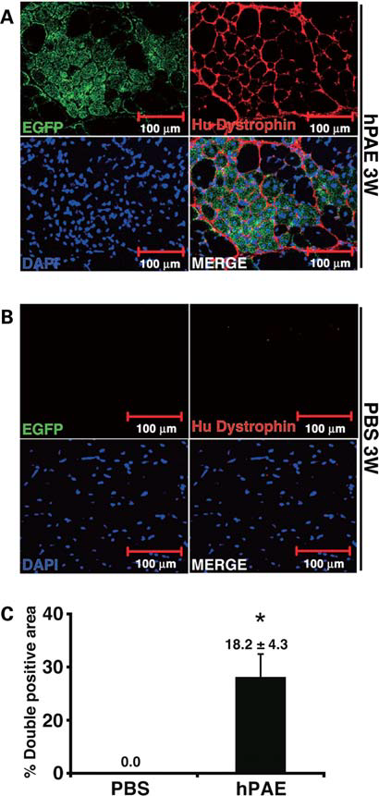
Conferral of human dystrophin by cell implantation in the mdx mouse
Investigate whether hPAE cells can confer human dystrophin to myocytes
Untreated EGFP-labelled hPAE cells were injected into mdx mice
PBS injected into the contralateral muscle as a control
Human dystrophin is transcribed from the dystrophin gene of human donor cells.
Notes:
Expression of dystrophin was not caused by reversion to normal phenotype of dystrophied myocytes in the mdx mice because the antibody used in this study is specific to humans. These results suggest that human dystrophin is transcribed from the dystrophin gene of human donor.

Slide 19
Summary
hPAE cells have a high replicative ability similar to progenitors or stem cells
Immunosuppressive hPAE cells with myogenic potential offers an avenue for cell based therapy.
Survival of donor cells in an immunocompetent mouse is attributed to HLA-E dependent immunosuppression
hPAE cells were converted into myotubes in vitro after induction, giving rise to large number of microfibers expressing human dystrophin when transplanted into BALB/c and mdx mice

Slide 20
Future Research
Focus on the Dystrophin gene (gene therapy)
Identify portion of the dystrophin gene that are deregulated e.g COOH terminal
Isolation of tissue specific MSC for expansion in vitro and transplant back into the patients in an allogenic manner.
Critique
Factors that suppress classical MHC I (HLA-A, B, C)
Factors that regulate dystrophin expression and what area of the dystrophin gene had the mutation.

